Slide 1

CMR TECHNICAL CAMPUS
DEPARTMENT OF INFORMATION TECHNOLOGY
MAJOR PROJECT STAGE-II
REVIEW-II
PROJECT TITLE: AGROLANDTRUST-5.0:A BLOCKCHAIN-AI FRAMEWORK FOR TAMPER-PROOF LAND REGISTRATION AND FRAUD DETECTION IN SMART AGRICULTURE
Presented by:
Batch No: 02
1. H. No: 227R1A12B9 Name: P. Vaishnavi
2. H. No: 227R1A12B2 Name: M. Anusha
3. H. No: 237R5A1213 Name: R. Rakshith
4. H. No: 227R1A1299 Name: K. Rajesh
Project Supervisor:
Name: Md. Sajid Pasha
Designation: Assistant Professor

Slide 2

CONTENTS
Source Code
Results
Conclusion & Future Enhancement
References
GitHub Link
Introduction and Overview of the Project
Existing System
Disadvantages
Proposed System
Advantages
Software and Hardware Requirements
Novelty of the Project
System Architecture
Modules
UML Diagrams

Slide 3

INTRODUCTION AND OVERVIEW OF THE PROJECT
Land registration systems are critical for securing property ownership rights and enabling transparent transactions. Traditionally, these systems rely on centralized databases, which are susceptible to unauthorized modifications by administrators, resulting in ownership disputes, fraudulent transfers, and loss of public trust. A blockchain–AI framework designed to secure land registration and prevent fraud. Using IPFS for decentralized storage and Ethereum smart contracts for immutability, the system ensures tamper-proof records. AI models such as Logistic Regression, Random Forest, XGBoost, and CNN2D analyze transaction data to detect fraudulent activities in real time. Buyers and sellers interact through a web interface that enables registration, verification, and decision-making, ensuring transparency and trust in land transactions.

Slide 4

EXISTING SYSTEM
In the traditional land registration process, buyers and sellers rely on manual paperwork and government intermediaries to validate ownership, property records, and transactions. Land documents are physically stored in centralized government offices, and the transfer of ownership involves multiple verification steps, physical signatures, and approvals from different authorities. This system depends heavily on human intervention for verification, record-keeping, and conflict resolution, often requiring individuals to make repeated visits to offices for document submission, validation, and status updates.

Slide 5
EXISTING SYSTEM-DISADVANTAGES
The manual land registration system is prone to inefficiency, delays, and human errors, making the process time-consuming and unreliable.
Centralized storage of land records increases the risk of document tampering, forgery, and data loss due to natural disasters or mishandling.
Corruption and unauthorized alterations of records are common, leading to ownership disputes and fraudulent property transfers.

Slide 6

PROPOSED SYSTEM
The proposed system leverages blockchain and IPFS for decentralized, tamper-proof storage, with Ethereum smart contracts ensuring ownership proof. AI models, especially LightGBM, detect fraudulent patterns in real time. A Django-based web application allows buyers, sellers, and administrators to register, verify, and track transactions.By combining decentralization (IPFS + blockchain) with automation (smart contracts + AI inference), the system ensures higher security, transparency, fraud prevention, and trust in land registration processes compared to traditional manual systems.

Slide 7
PROPOSED SYSTEM-
ADVANTAGES
Immutability and Data Integrity
Enhanced Security
Transparency and Verifiability

Slide 8
SOFTWARE & HARDWARE REQUIREMENTS
SOFTWARE REQUIRMENTS
Programming Language : Python 3.7.6
Operating System : Windows
Framework : Django
HARDWARE REQUIRMENTS
Processor : intel i3 or above
Hard Disk : 1TB
RAM : 4 GB

Slide 9
NOVELTY OF THE PROJECT
The novelty of this project lies in combining AI-based fraud detection, IPFS-based decentralized document storage, and blockchain-based immutable transaction recording into a single real-time land transaction system. This project predicts fraud before approval, ensures transparency, eliminates data tampering, and provides a hybrid AI-human decision framework, making it more secure, scalable, and reliable than existing land registry systems.

Slide 10
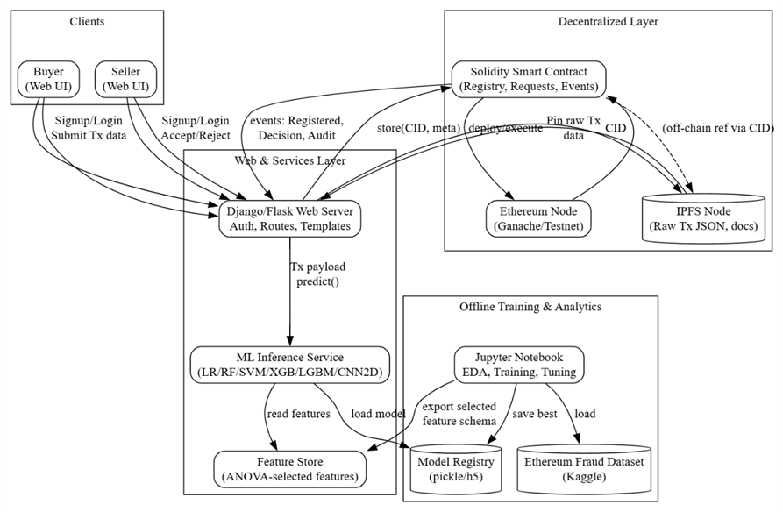
SYSTEM ARCHITECTURE

Slide 11
MODULES
1.Decentralized Layer Module
2.Web & Service Layer Module
3.Clients Module
4.ML Inference Service Module
5.Training & Analytics Module

Slide 12
1. DECENTRALIZED LAYER MODULE
Integrates Blockchain (Ethereum) and IPFS for secure, tamper-proof storage of land records.
Smart Contracts record ownership, transaction history, and verification data on-chain.
IPFS stores encrypted documents and returns a unique Content Identifier (CID) for reference.
Ensures data immutability, transparency, and non-repudiation of land transactions.

Slide 13
2. WEB & SERVICE LAYER MODULE
Handles user authentication, document upload, and transaction management through a web interface.
Connects with IPFS to store files and with Ethereum to register CIDs via smart contracts.
Communicates with ML Inference Service to check fraud probability before approval.
Maintains database for user data, transaction logs, and audit records.

Slide 14
3. CLIENTS MODULE
Includes Buyer and Seller dashboards for interaction with the system.
Allows users to upload, view, verify, and approve land documents securely.
Displays ML fraud detection results and blockchain verification proofs.
Provides an intuitive and responsive user interface for transparency and ease of use.

Slide 15
4. ML INFERENCE SERVICE MODULE
Performs fraud detection and verification on transaction and document data.
Uses trained machine learning models to predict fraudulent activities.
Sends a fraud probability score and explanation back to the Web Layer.
Ensures real-time, accurate, and explainable AI predictions using LightGBM/CNN models.

Slide 16
5. TRAINING & ANALYTICS MODULE
Collects and preprocesses historical transaction data for model training.
Trains and updates fraud detection and pattern recognition models regularly.
Uses analytics dashboards to visualize fraud trends and model performance.
Monitors model accuracy and retraining needs to ensure reliability.
.

Slide 17
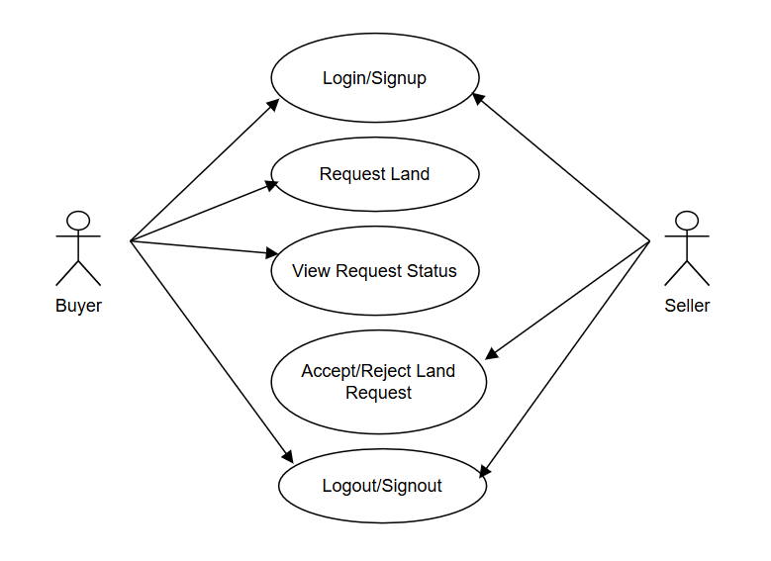
UML DIAGRAMS
USE CASE DIAGRAM

Slide 18
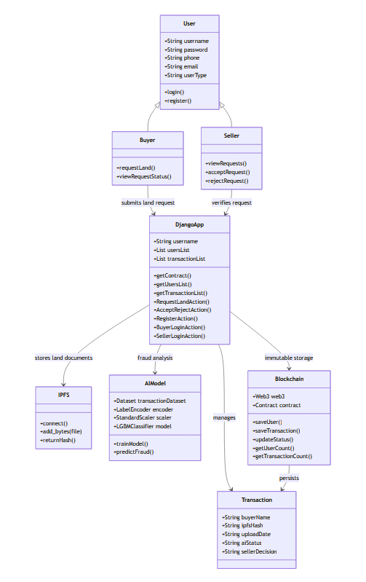
CLASS DIAGRAM
Part 1 Part 2

Slide 19
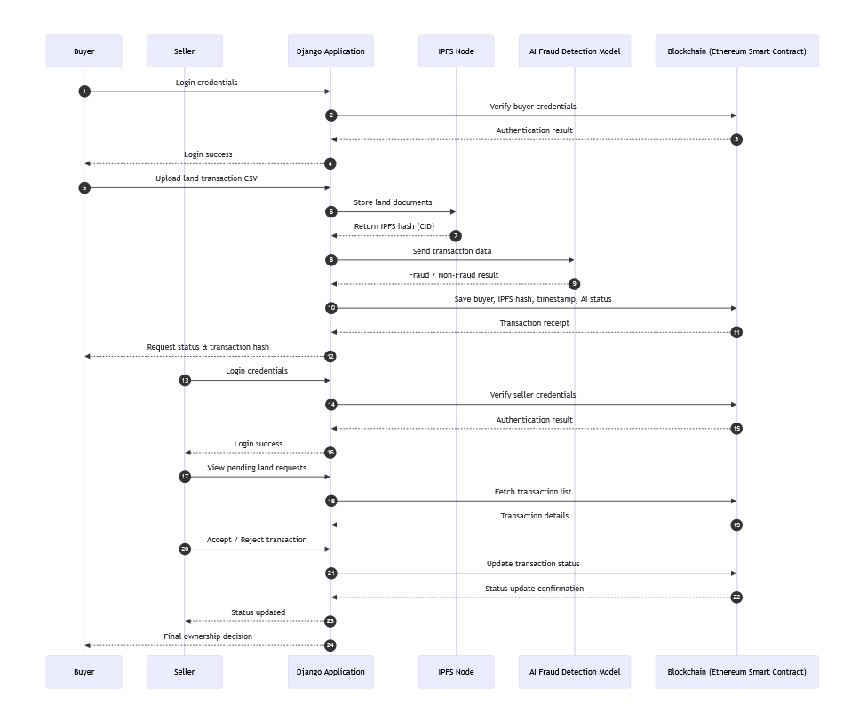
SEQUENCE DIAGRAM
Part 1

Slide 20
Part 2

Slide 21
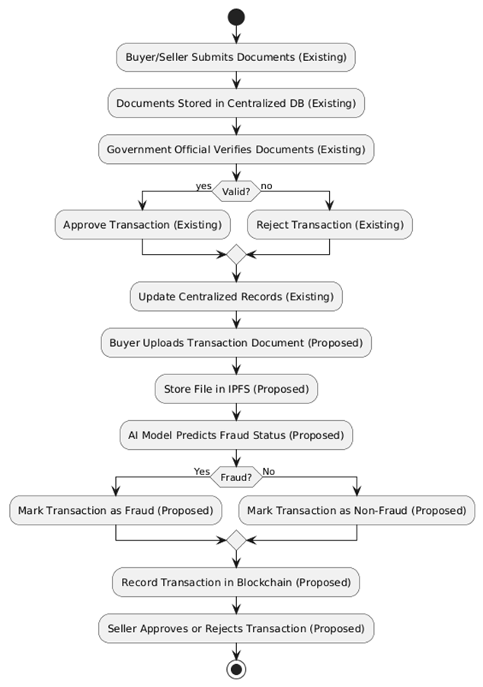
ACTIVITY DIAGRAM

Slide 22
SOURCE CODE
1. Blockchain Connection (Smart Contract Interaction)
from web3 import Web3, HTTPProvider import json def getContract(): blockchain_address = 'http://127.0.0.1:9545' web3 = Web3(HTTPProvider(blockchain_address)) web3.eth.defaultAccount = web3.eth.accounts[0] compiled_contract_path = 'GreenLand.json' deployed_contract_address = '0xB50Bb6b655f7f214076003c171C82Ee633e6fFfa' with open(compiled_contract_path) as file: contract_json = json.load(file) contract_abi = contract_json['abi'] contract = web3.eth.contract(address=deployed_contract_address, abi=contract_abi) return contract

Slide 23
2. IPFS File Upload (Document Storage)
3. AI Fraud Detection Model
import ipfshttpclientapi = ipfshttpclient.connect('/ip4/127.0.0.1/tcp/5001’)
def uploadToIPFS(file_data):
hashcode = api.add_bytes(file_data)
return hashcode
from lightgbm import LGBMClassifier
lg_cls LGBMClassifier(learning_rate=0.1)
lg_cls.fit(X_train, y_train)
def detectFraud(testData):
prediction = lg_cls.predict(testData)
if prediction == 1:
return "Fraud"
else:
return "Non-Fraud"

Slide 24
4. Buyer Upload Land Transaction Request
5. Seller Approve / Reject Transaction
def RequestLandAction(request):
if request.method == 'POST':
file = request.FILES['t1'].read()
hashcode = api.add_bytes(file)
status = detectFraud(testData)
msg = contract.functions.saveTransaction( username, hashcode, status ).transact() web3.eth.waitForTransactionReceipt(msg)
def AcceptRejectAction(request):
index = request.GET.get('t1')
status = request.GET.get('t2')
msg = contract.functions.updateStatus( int(index), status
).transact() web3.eth.waitForTransactionReceipt(msg)

Slide 25
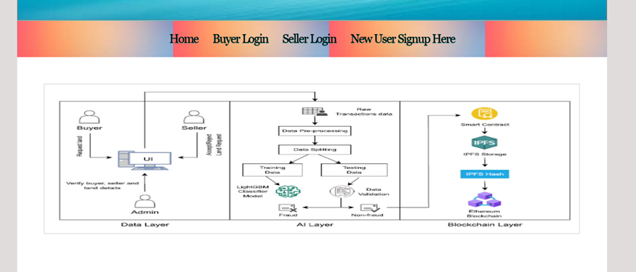
RESULTS
Fig. 1: Home Page of a Secure Land Registration Scheme

Slide 26
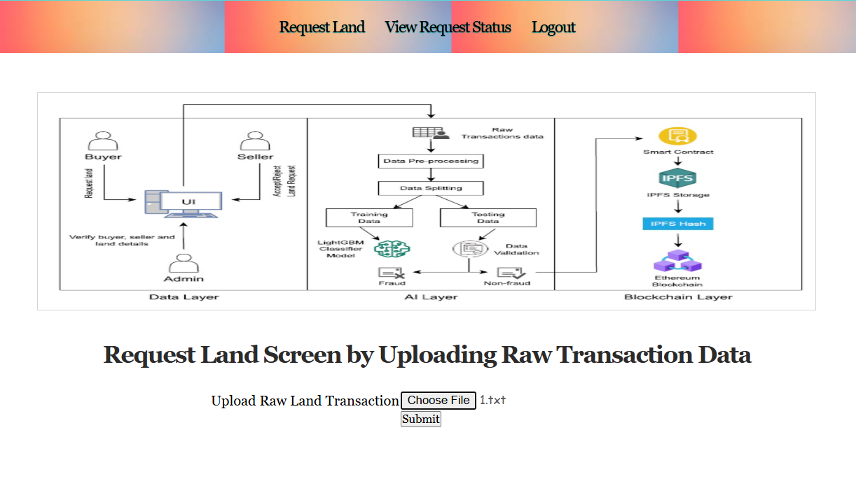
Fig. 2: Request Land Screen

Slide 27
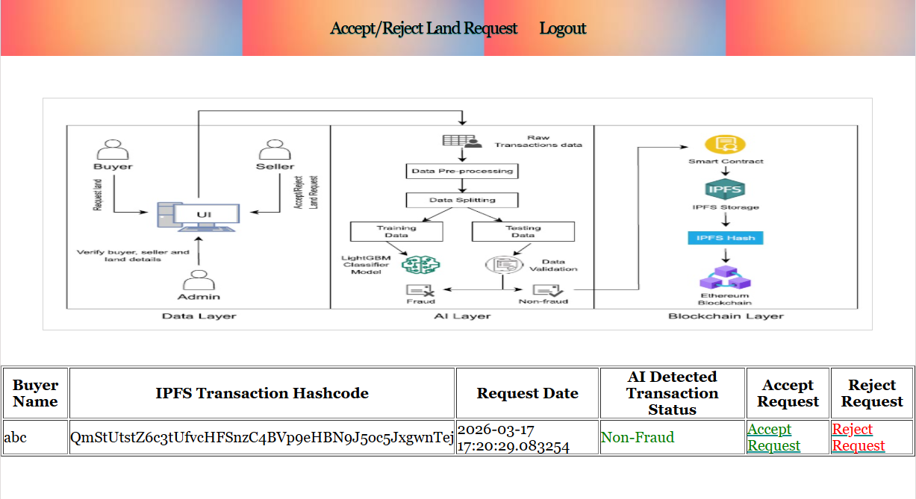
Fig. 3: Accept/Reject Action Screen

Slide 28
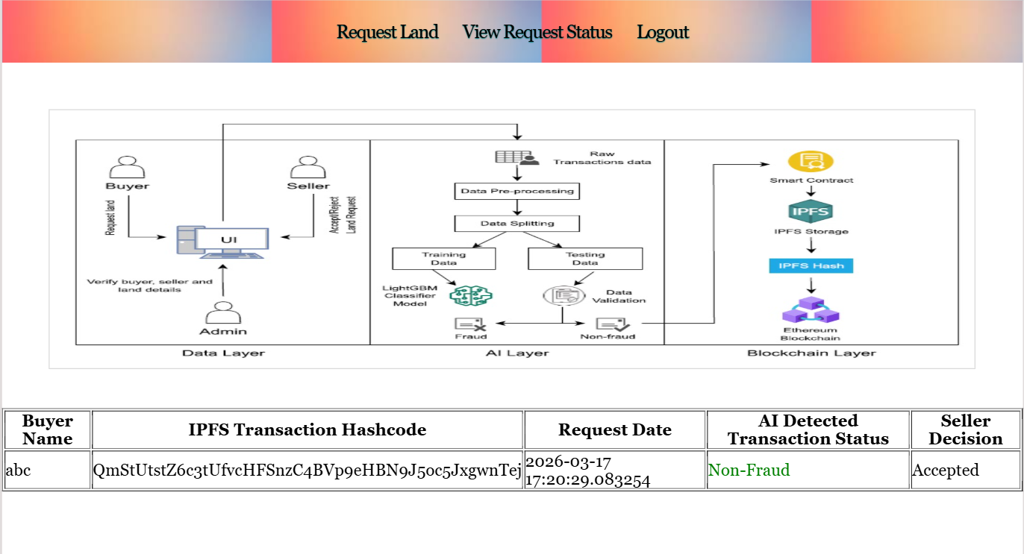
Fig. 4: View Request Status Screen

Slide 29
CONCLUSION & FUTURE ENHANCEMENT
AgroLandTrust 5.0 presents a secure and transparent framework for land registration by integrating Blockchain, AI-based fraud detection, and IPFS decentralized storage. The system ensures tamper-proof records, secure document storage, and automated detection of fraudulent transactions, improving trust and efficiency in smart agriculture land management. In the future, the system can be enhanced by integrating government land record databases, mobile applications for farmers, advanced deep learning models for better fraud detection, biometric authentication, and GIS-based land mapping to further improve scalability, security, and usability.

Slide 30
REFERENCES
[1] R. Kumar, S. Patel and A. Reddy, “Blockchain-AI Framework for Tamper-Proof Land Registration and Fraud Detection in Smart Agriculture,” International Journal of Information Management Data Insights, vol. 5, no. 1, p. 100210, 2025, doi: 10.1016/j.jjimei.2025.100210.
[2] F. Naguji et al., “AGROLand: A Secure Land Registration Scheme for Blockchain and AI-Enabled Agriculture Industry 5.0,” IEEE Access, vol. 12, pp. 120994–121009, 2024, doi: 10.1109/ACCESS.2024.3451627.
[3] V. Sharma, P. Singh and K. Verma, “Secure Land Transaction System Using Blockchain, IPFS and Machine Learning-Based Fraud Detection,” IEEE Access, vol. 11, pp. 145678–145690, 2023, doi: 10.1109/ACCESS.2023.3298765.

Slide 31
GITHUB LINK
https://github.com/Vaishnavi-Parsa/A-Blockchain-AI-framework-for-tamperproof-land-registration-and-fraud-detection-in-smart-agriculture

Slide 32

THANK YOU

